Slide 1
Muzix Application
Presented By:
Seetha Lakshmi.G.M
Shubham Pawar
Mridul Bhawa

Slide 2
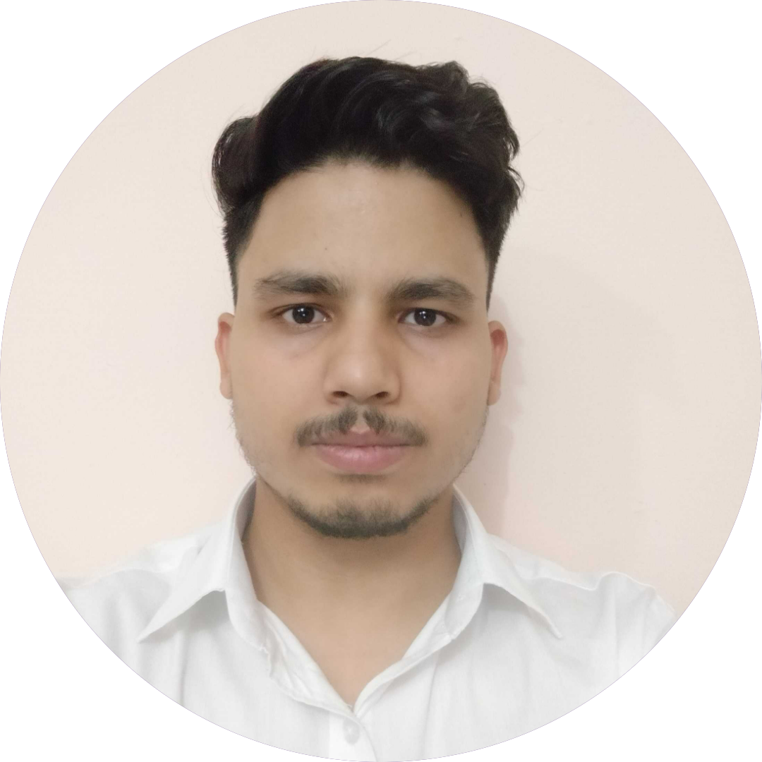
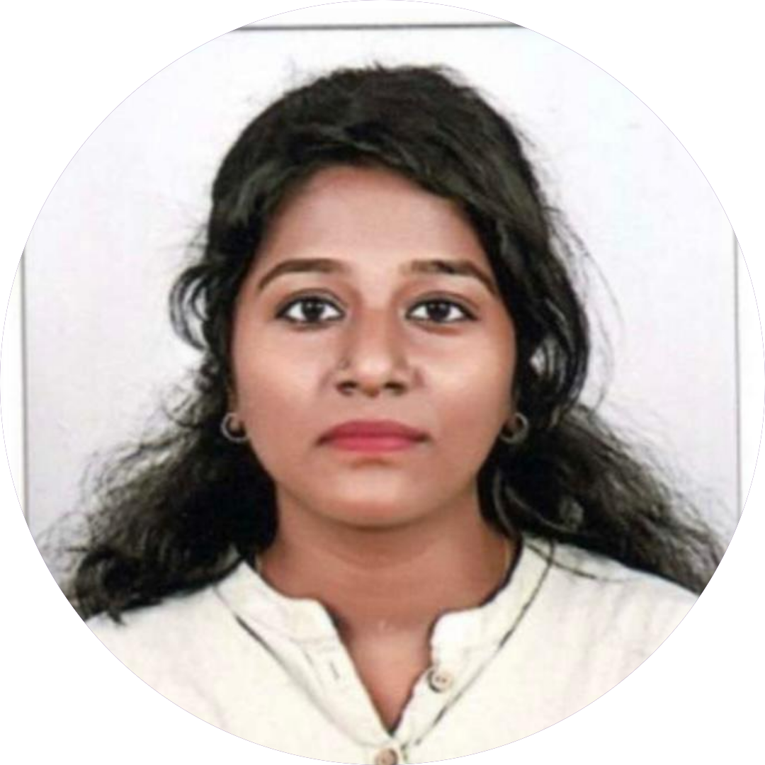

TEAM MEMBERS
MRIDUL BHAWA
SEETHA LAKSHMI.G.M
SHUBHAM PAWAR

Slide 3
About the Application
The project is a complete movie application by which user can view, search movies as per their requirements .
The application can visualize recommended movies as per users' choice.
The user can add the movies to their favorite list.
and recommended movies as per users' choice.

Slide 4
Features of the application
Register
Login
Movie View
Search
Favourite
Recommended
Play Trailer

Slide 5
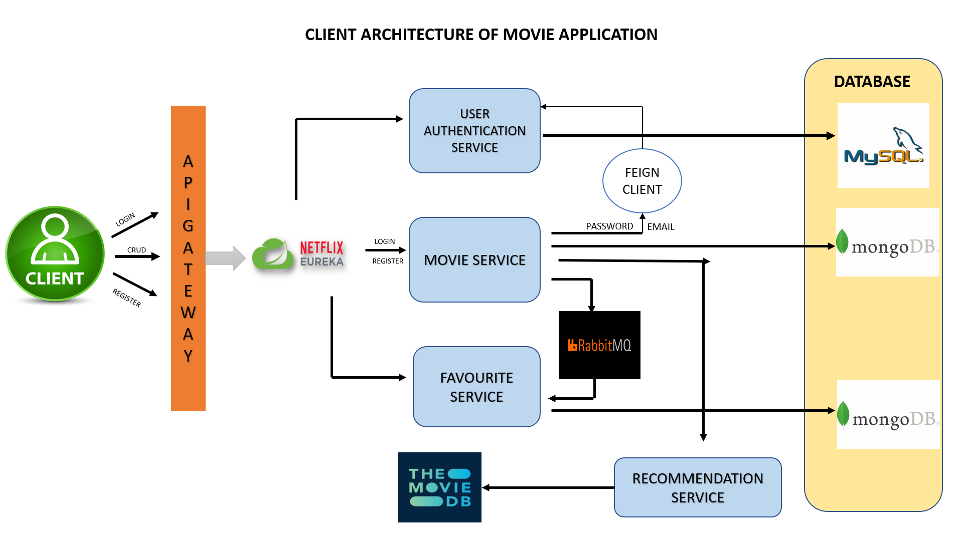

Slide 6
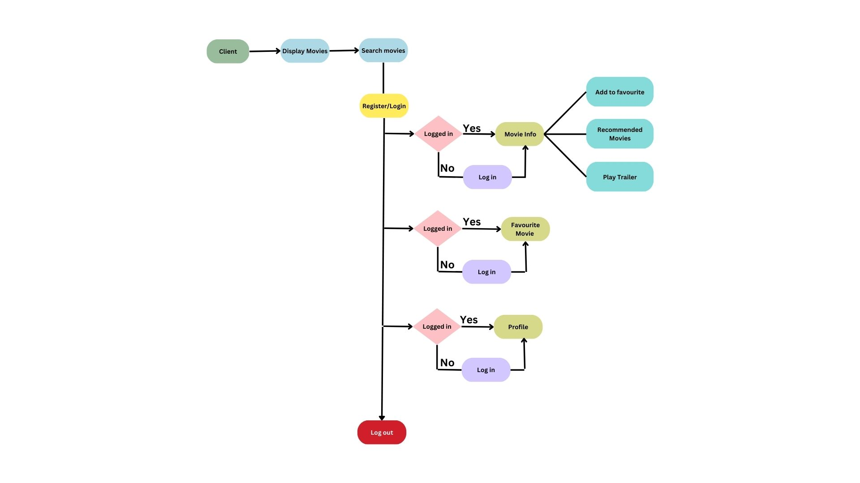
Work Flow Diagram
5

Slide 7





Technologies Used for the Back End

Slide 8





Technologies Used for the Front End

Slide 9


Databases used

Slide 10
Functionalities
Register - User can register using their credentials and profile picture
Login – The registered user is able to login and access the features of the application
Movie View – The user can view the details of the particular movie
Search – User can search with movie name.
Favourite – User can add or remove movie from their favourite list
Recommended – User can view the recommended movies of particular genre
Play Trailer – User is able to play the trailer of the movie.

Slide 11
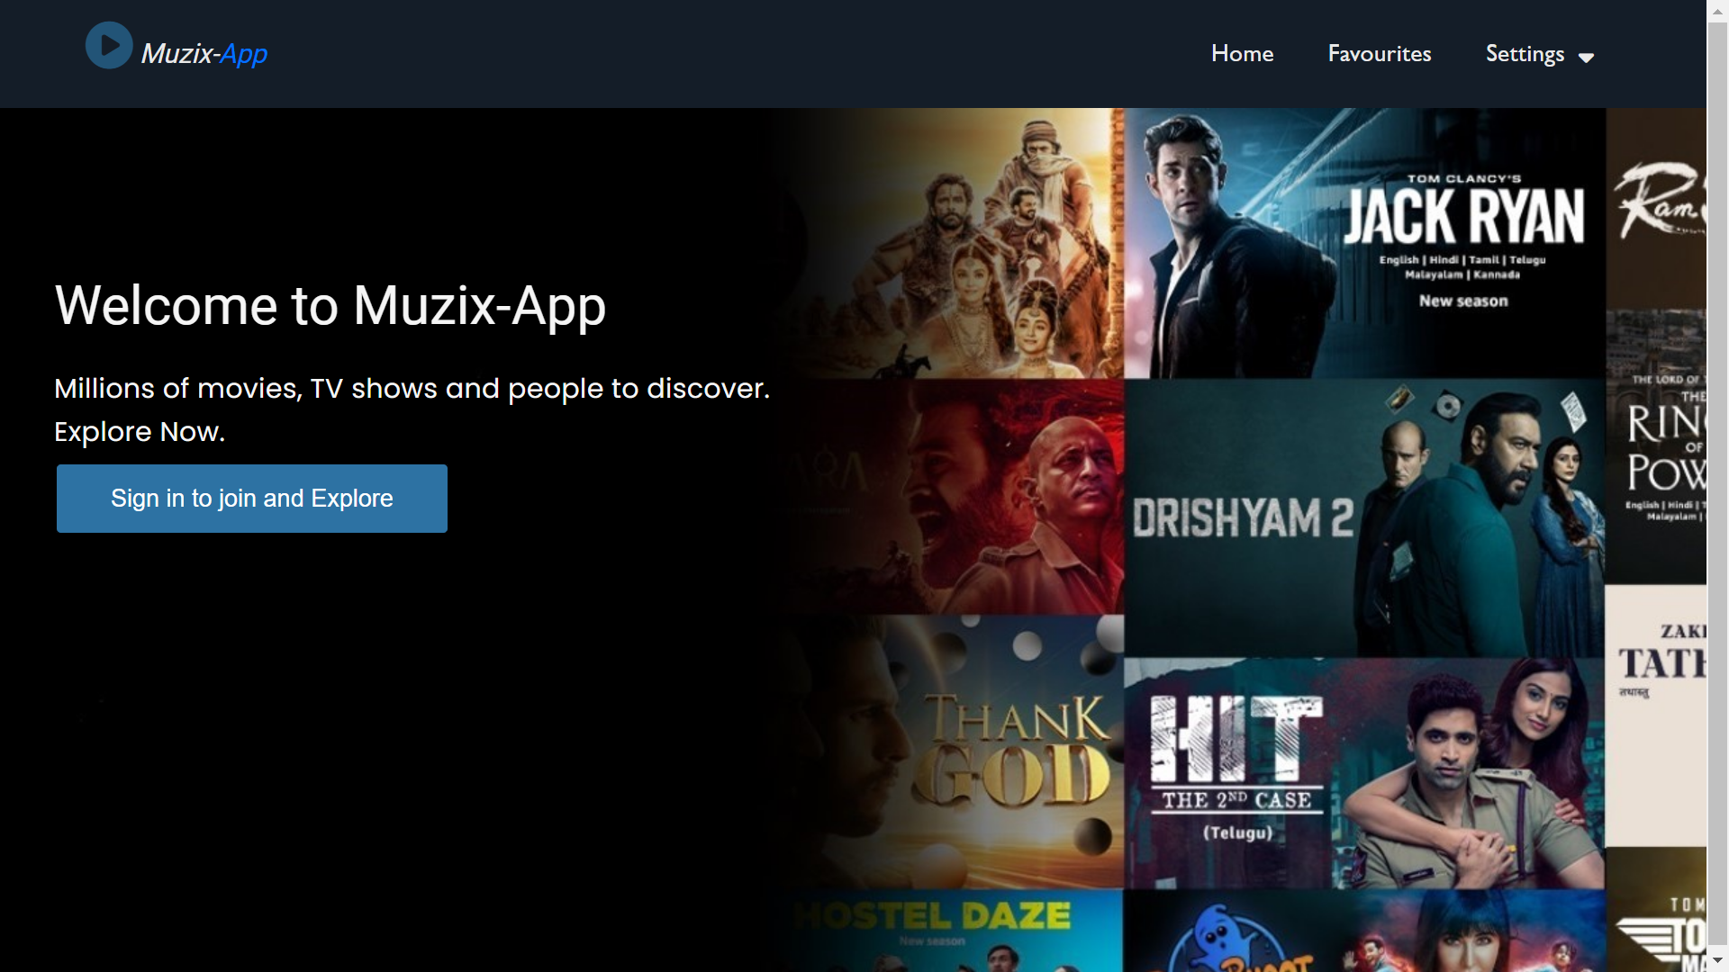
INTERACTIVE DEMO

Slide 12
Future Enhancements
A more robust search function that allows users to search for movies and shows by specific criteria, such as director, actor, genre, and release year.
More detailed cast and crew information, including biographies and filmographies.
More interactive features, such as a social media-like feed where users can follow their favorite actors and directors and see updates on their upcoming projects.
Adding a section with links to different OTT platforms where the movie is present.
More linear, live broadcasts like sports, concerts and political events
More personalized advertising

Slide 13
Q&A

Slide 14
Thank You

